Slide 1
INTERNET PROTOCOL (IP)

Slide 2
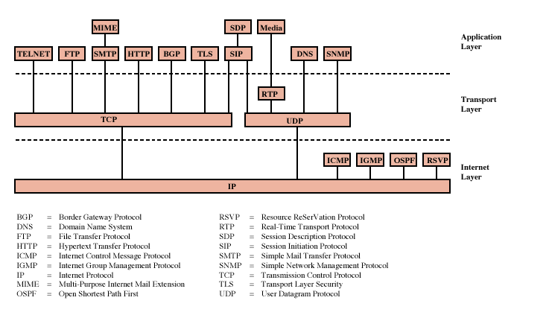
Protocols of TCP/IP Protocol Suite

Slide 3
Internet Protocol (IP)
Internet Protocol is one of the major protocols in the TCP/IP protocols suite.
This protocol works at the network layer of the OSI model and at the Internet layer of the TCP/IP model.
IP provides connectionless (datagram) service ; Each packet treated separately
Datagrams
  Packets in the network (internet) layer are called datagrams.
  A datagram is a variable-length packet consisting of two parts: header and data.
  The header is 20 to 60 bytes in length and contains information essential to routing and delivery.
  It is customary in TCP/IP to show the header in 4-byte sections.

Slide 4
Network layer protocol common to all routers
This protocol has the responsibility of identifying hosts based upon their logical addresses and to route data among them over the underlying network.
IP provides a mechanism to uniquely identify hosts by an IP addressing scheme.
IP uses best effort delivery, i.e. it does not guarantee that packets would be delivered to the destined host, but it will do its best to reach the destination.
Internet Protocol version 4 uses 32-bit logical address.

Slide 5
Design Issues
Routing
Datagram lifetime
Fragmentation and re-assembly
Error control
Flow control
Addressing

Slide 6
Routing
End systems and routers maintain routing tables
  Indicate next router to which datagram should be sent
  Static
    Tables do not change but may contain alternative routes
  Dynamic
    If needed, the tables are dynamically updated
    Flexible response to congestion and errors
    status reports issued by neighbours about down routers
Source routing
  Source specifies route as sequential list of routers to be followed
  useful, for example, if the data is top secret and should follow a set of trusted routers.
Route recording
  routers add their address to datagrams
  good for tracing and debugging purposes

Slide 7
Datagram Lifetime
Datagrams could loop indefinitely
  Not good
    Unnecessary resource consumption
    Transport protocol needs upper bound on datagram life
Datagram marked with lifetime
  Time To Live (TTL) field in IP
  Once lifetime expires, datagram is discarded (not forwarded)
  Hop count
    Decrement time to live on passing through each router
  Time count
    Need to know how long since last router
    global clock is needed

Slide 8
Fragmentation and Re-assembly
Different maximum packet sizes for different networks
  routers may need to split the datagrams into smaller fragments
When to re-assemble
  At destination
    Packets get smaller as data travel
      inefficiency due to headers
  Intermediate reassembly
    Need large buffers at routers
    All fragments must go through same router
      Inhibits dynamic routing

Slide 9
IP Fragmentation
In IP, reassembly is at destination only
Uses fields in header
  Data Unit Identifier –
  In order to uniquely identify datagram – all fragments that belong to a datagram share the same identifier
    Source and destination addresses
    Upper protocol layer (e.g. TCP)
    Identification supplied by that layer
  Data length
    Length of user data in octets (if fragment, length of fragment data)
    Actually header contains total length but data length can be calculated
  Offset
    Position of fragment of user data in original datagram (position of the first byte of the fragment)
    In multiples of 64 bits (8 octets)
  More flag
    Indicates that this is not the last fragment (if this flag is 1)

Slide 10
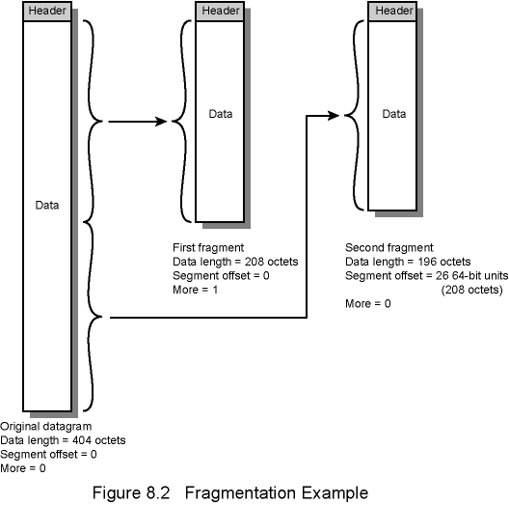
Fragmentation Example

Slide 11
Dealing with Failure
Reassembly may fail if some fragments get lost
Need to detect failure to free up the buffers
One solution: Reassembly time out
  Assign a reassembly lifetime to the first fragment
  If timer expires before all fragments arrive, discard partial data

Slide 12
Error Control
In IP, delivery is not guaranteed
Router may attempt to inform source if packet discarded, if possible
  specify the reason of drop, e.g. for time to live expiration, congestion, bad checksum (error detected)
Datagram identification needed
When source receives failure notification, it
  may modify transmission strategy
  may inform high layer protocol
such a failure notification is not guaranteed

Slide 13
Flow Control (in IP layer)
Allows routers and/or stations to limit rate of incoming data
In connectionless systems (such as IP), mechanisms are limited
Send flow control packets requesting reduced flow
  e.g. using source quench packet of ICMP

Slide 14
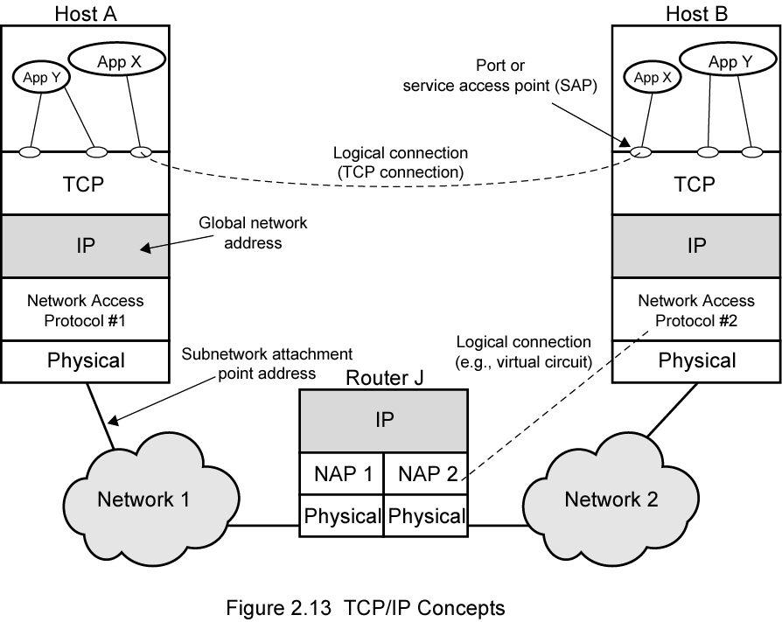
Addressing in TCP/IP
port

Slide 15
Addressing Level
Level in communication architecture at which entity is named
Unique address for each end system
  e.g. workstation or server
And each intermediate system
  (e.g., router)
Network-level address
  IP address or internet address
  OSI - network service access point (NSAP)
  Used to route PDU through network
At destination data must routed to some process
  Each process assigned an identifier
  TCP/IP port
  Service access point (SAP) in OSI

Slide 16
IP Datagram

Slide 17
Internet Protocol being a layer-3 protocol (OSI) takes data Segments from layer-4 (Transport) and divides it into packets. IP packet encapsulates data unit received from above layer and add to its own header information.
The encapsulated data is referred to as IP Payload. IP header contains all the necessary information to deliver the packet at the other end.

Slide 18
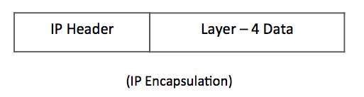
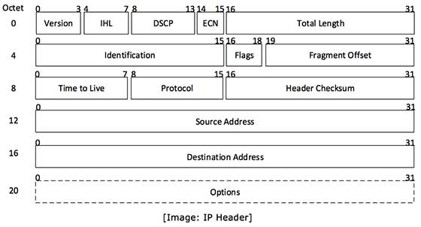

Slide 19
Header Fields
Version
  Version no. of Internet Protocol used (e.g. IPv4).
Internet header length
  Length of entire IP header.
  Unit is 32 bit words
  Including options
  minimum 5 (means 20 octets)
DSCP Differentiated Services Code Point
  Earlier it is “Type of Service”
  Used for QoS support
ECN (Explicit Congestion Notification)
  It carries information about the congestion seen in the route.

Slide 20
Header Fields
Total length
  Length of entire IP Packet (including IP header and IP Payload) in octets
Identification
  If IP packet is fragmented during the transmission, all the fragments contain same identification number to identify original IP packet they belong to.
  Sequence number
  Used with addresses and user protocol to identify datagram uniquely
Flags
  As required by the network resources, if IP Packet is too large to handle, these ‘flags’ tells if they can be fragmented or not.
  More bit
  Don’t fragment

Slide 21
Fragmentation offset
  This offset tells the exact position of the fragment in the original IP Packet.
Time to live
  To avoid looping in the network, every packet is sent with some TTL value set, which tells the network how many routers (hops) this packet can cross. At each hop, its value is decremented by one and when the value reaches zero, the packet is discarded.
Protocol
  Next higher layer to receive data field at destination
  Tells the Network layer at the destination host, to which Protocol this packet belongs to, i.e. the next level Protocol. For example protocol number of ICMP is 1, TCP is 6 and UDP is 17.

Slide 22
Header Fields
Header checksum
  This field is used to keep checksum value of entire header which is then used to check if the packet is received error-free.
  Verified and recomputed at each router
Source address
  32-bit address of the Sender (or source) of the packet.
Destination address
  32-bit address of the Receiver (or destination) of the packet.

Slide 23
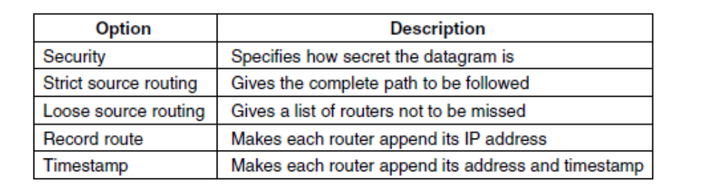
Options
  This is optional field, which is used if the value of IHL is greater than 5. These options may contain values for options such as Security, Record Route, Time Stamp, etc.
Padding
  To fill to multiple of 32 bits long

Slide 24
Data Field
User (upper layer) data
any octet length is OK
  But max length of IP datagram (header plus data) is 65,535 octets

Slide 25
IP Fragmentation

Slide 26
Maximum Transmission Unit (MTU)
An IP packet that is larger than the Maximum Transmission Unit (MTU) of an interface, is too large for transmission over that interface.
The packet must either be fragmented, or discarded (and an ICMP error message returned to the sender).
In either case, the original data will be fragmented into smaller packets (less than the smallest MTU) in order to allow it to be received by the final destination system.

Slide 27
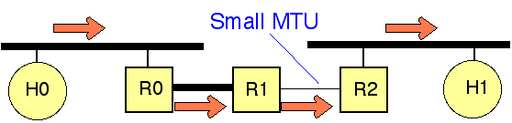
Two Approaches
IP Router Segmentation - performing the fragmentation in the routers
IP Path MTU Discovery - forcing the sender to perform the fragmentation

Slide 28
IP Fragmentation processing at a Router/
IP Router Segmentation
In this simple approach, the sender simply has to ensure that each packet is less than the MTU of the link on which it is sent. (The router always knows this from the link interface configuration information).
The network layer then has to arrange to cut packets up into smaller fragments whenever a router encounters a link with an MTU smaller than the received IP packet size.
All the fragments of an IP packet carry the same ID in the IP packet header (allowing the final receiver to reassemble the fragmented parts into the original PDU). This is called "IP fragmentation" or "IP segmentation".

Slide 29
The problem is, this offloads a lot of work on to routers, and in the worst case, can also result in packets being segmented by several IP routers one after another, resulting in very peculiar fragmentation.
IP Router fragmentation is not recommended in the modern Internet

Slide 30
IP Fragmentation processing at a Sender/ IP Path MTU Discovery
Path MTU Discovery allows a sender to fragment/segment a long internet packet, rather than relying on routers to perform IP-level fragmentation.
This is more efficient and more scalable.
It is therefore the recommended method in the current Internet.

Slide 31
IP Reassembly processing at the Receiving End System
IP fragmentation and reassembly employs updating and using the values in the second 32 bits of the IPv4 packet header.
An end system that accepts an IP packet (with a destination IP address that matches its own IP source address) will also reassemble any fragmented IP packets before these are passed to the next higher protocol layer.

Slide 32
The system stores all received fragments (i.e., IP packets with a more-fragments flag (MF)set to one, or where the fragment offset is non-zero), in one of a number of buffers (memory space).
Packets with the same 16-bit Identification value are stored in the same buffer, at the offset specified by the fragment offset field specified in the packet header.
Packets which are incomplete remain stored in the buffer until either all fragments are received, OR a timer expires, indicating that the receiver does not expect to receive any more fragments.
Completed packets are forwarded to the next higher protocol layer.

Slide 33
Fragmentation and IP Fields
More Fragments field (1 bit)
  1 if more fragments
  0 if not
  Source host internet process sets to 0
  If router fragments, sets More Fragments field in last fragment to 0
  In all other fragments, sets to 1
0
0
1
1
Original IP Packet
Fragments

Slide 34
Identification Field
IP packet has a 16-bit Identification field
Version
(4)
Hdr Len
(4)
TOS (8)
Total Length in bytes (16)
Indication (16 bits)
Flags (3)
Fragment Offset (13)
Time to Live (8)
Protocol (8)
Header Checksum (16)
Source IP Address
Destination IP Address
Options (if any)
PAD
Data Field

Slide 35
Identification Field
IP packet has a 16-bit Identification field
  Source host internet process places a random number in the Identification field
  Different for each IP packet
Version
(4)
Hdr Len
(4)
TOS (8)
Total Length in bytes (16)
Indication (16 bits)
Flags (3)
Fragment Offset (13)
Time to Live (8)
Protocol (8)
Header Checksum (16)

Slide 36
Identification Field
IP packet has a 16-bit Identification field
  If router fragments, places the original Identification field value in the Identification field of each fragment
47
47
47
47
Original IP Packet
Fragments

Slide 37
Identification Field
Purpose
  Allows receiving host’s internet layer process know what fragments belong to each original packet
  Works even if an IP packet is fragmented several times
47
47
47
47
Original IP Packet
Fragments

Slide 38
Fragment Offset Field
Fragment offset field (13 bits) is used to reorder fragments with the same Identification field
Contains the data field’s starting point (in octets) from the start of the data field in the original IP packet
Version
(4)
Hdr Len
(4)
TOS (8)
Total Length in bytes (16)
Indication (16 bits)
Flags (3)
Fragment Offset (13)

Slide 39
Fragment Offset Field
Receiving host’s internet layer process assembles fragments in order of increasing fragment offset field value
This works even if fragments arrive out of order!
Works even if fragmentation occurs multiple times
Fragment Offset Field
730
212
0

